Slide 1
Ideate and Implement a System to Enhance the Quality of Education in Rural Areas
CSE7101- Capstone Project
FINAL REVIEW – 5
Batch Number: IST_9
Roll Number | Student Name
20221IST0009 | YASHWITHA T
20221IST0011 | GUDDITI YASHWANTH KUMAR
20221IST0036 | VARSHA B
Under the Supervision of,
Ms. Monisha Gupta
Assistant Professor
School of Computer Science and Engineering
Presidency University
Name of the Program: B.TECH
Name of the HoD: Dr. Pallavi R
Name of the Program Project Coordinator: Ms. Benitha Christinal J
Name of the School Project Coordinators: Dr. Sampath A K , Dr. Geetha A

Slide 2
Introduction
Education in rural areas faces challenges such as lack of resources, limited teacher availability, and outdated learning materials.
Many students do not get access to proper study content, which affects their academic growth.
Our project aims to bridge this digital divide by creating an online learning platform that provides simple, accessible, and quality digital content specifically designed for rural learners.
The system supports self-learning, improves academic understanding, and empowers students with modern digital education tools.

Slide 3
Problem Statement Number: PSCS_32
Organization: Government of Kerala
Category (Hardware / Software / Both) : Software
Problem Description:
Ideate and implement a system to enhance the quality of education in rural areas. The aim of the system is not
only to improve literacy rates but also to strengthen the overall learning experience for rural students. This
includes developing their communication skills, enhancing subject knowledge, and providing access to modern
educational resources. The system will focus on bridging the gap between urban and rural education by offering
both online and offline learning opportunities. It will also promote skill development, mentorship, and awareness
about government schemes, ultimately contributing to the personal and professional growth of the targeted
community.

Slide 4
Objectives
This project aims to:
Develop a simple, easy-to-use online learning portal for rural students.
Provide notes, videos, quizzes, and explanations in an organized manner.
Enable independent learning without full dependence on the teacher.
Make digital content available using minimal internet bandwidth.
Encourage continuous learning and improve student confidence.
Support teachers with a platform where they can upload study material easily.

Slide 5
Existing System Drawbacks
In the current rural education system:
Learning depends entirely on classroom teaching; no digital backup is available.
Students cannot revise lessons effectively because of lack of structured digital notes.
There is no platform for interactive learning or online practice.
During teacher absence or poor teaching quality, students have no alternative support.
Traditional systems do not track student understanding or learning progress. These drawbacks cause gaps in knowledge and lower academic outcomes.

Slide 6
Proposed System
Our proposed system is an online education platform specifically designed for rural learners. It includes:
A simple user interface where students can select subjects.
Learning materials like notes, PDF resources, video links, and chapter-wise explanations.
A quiz system to help students check their understanding.
A backend that stores progress and learning patterns. The platform focuses on being lightweight, mobile-friendly, and usable even with low-speed internet.

Slide 7
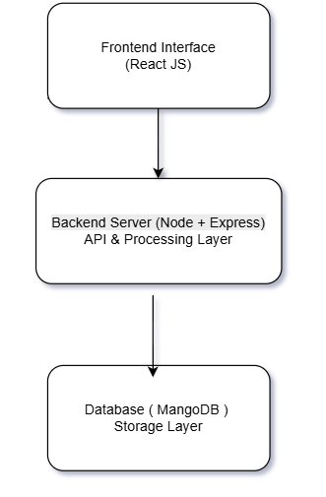
Block Diagram
This architecture shows how the system works:
Frontend (React JS): The user interacts with the system through a web or app interface built using React JS.
Backend (Node + Express): When the user performs any action, the backend processes the request, handles logic, and provides the required response.
Database (MongoDB): All data such as student profiles, attendance, and content is stored and retrieved from MongoDB.

Slide 8
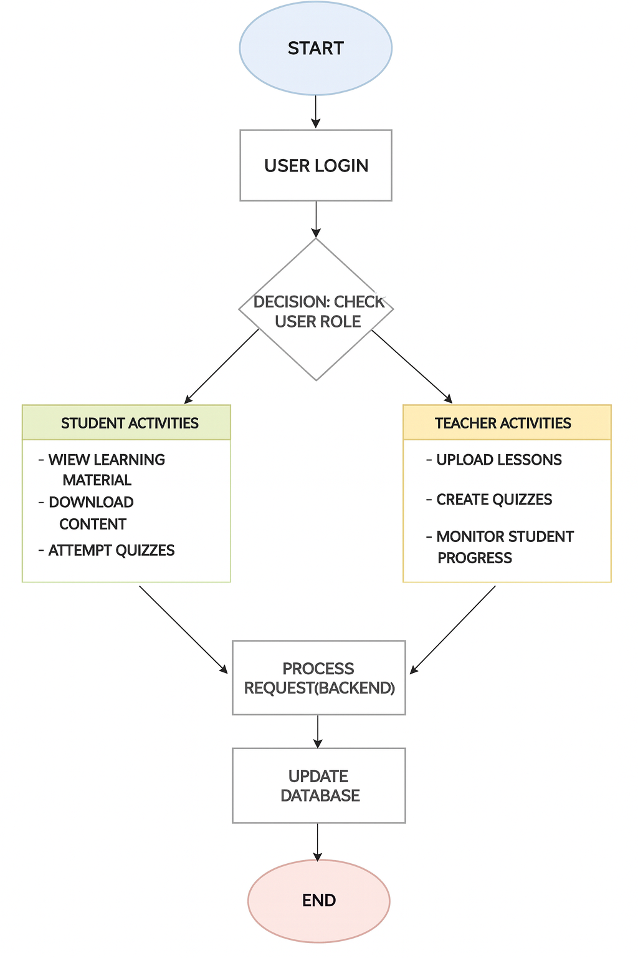
System Flowchart
The system begins when the user logs in. It first checks whether the user is a student or a teacher. Students can access learning materials and attempt quizzes, while teachers can upload content and track student progress. Every action is processed by the backend and the database is updated accordingly. After completing the task, the system waits for the next user action.

Slide 9
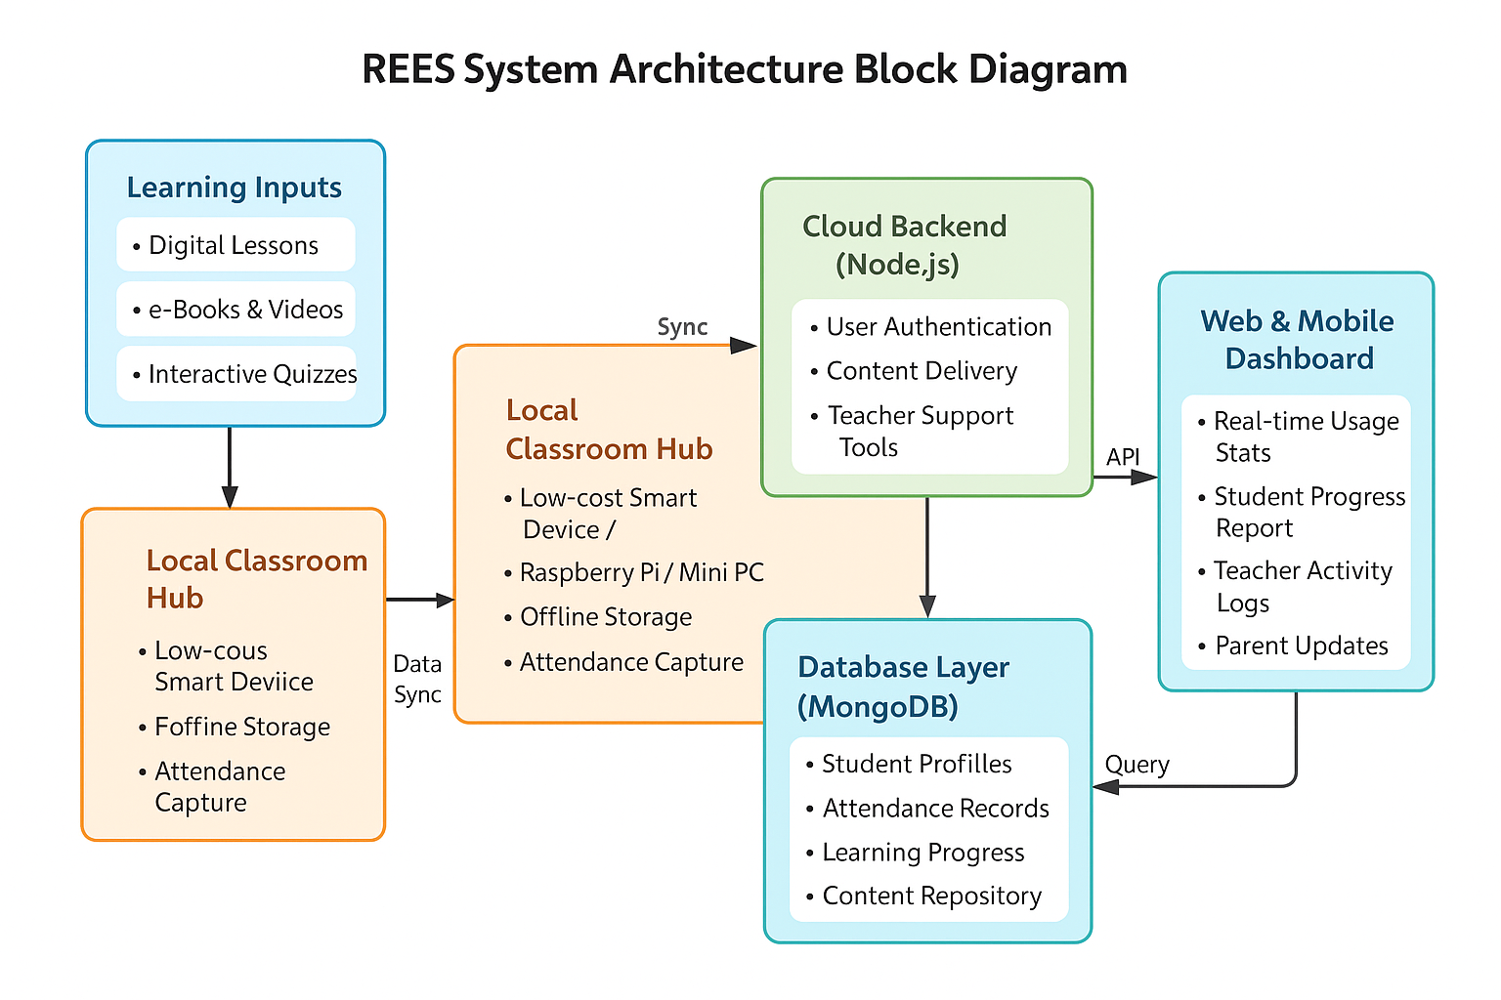
System Architecture
The system takes digital lessons and learning materials and sends them to a Local Classroom Hub, which
works even without internet. This hub stores content and captures attendance. When online, it syncs data
to the Cloud Backend, where authentication and content management happen. All information is saved in
the MongoDB database. Teachers, students, and parents can then view progress, reports, and updates
through the Web/Mobile Dashboard.

Slide 10
User Interface Screens
These images show the working pages of our platform, including the homepage, subjects section, notes page, and quiz interface. The interface is intentionally kept simple so rural students can easily navigate without needing technical knowledge.

Slide 11
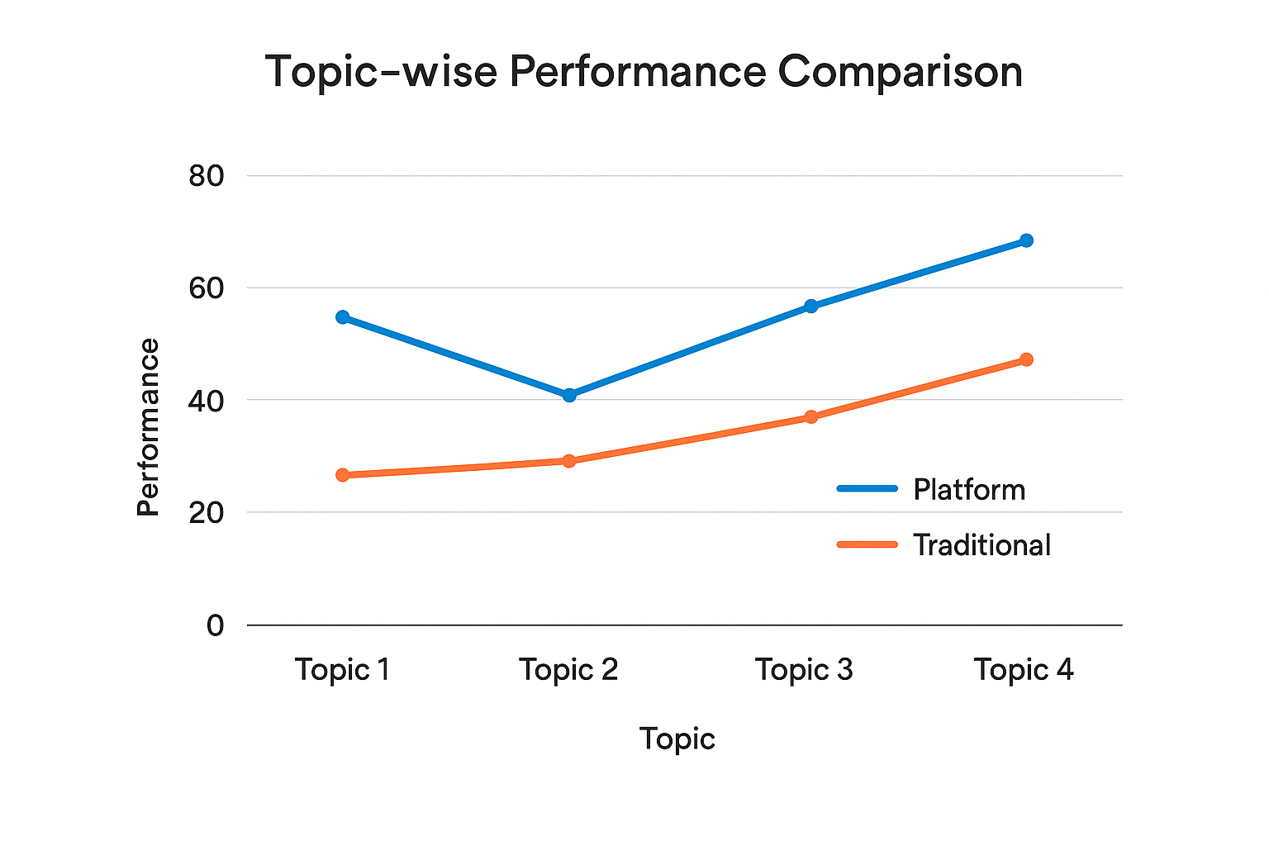
Results & Performance Analysis
The line graph compares student performance across different topics before and after using the digital learning platform. The scores clearly rise in every topic when the digital system is used, showing that students understood the lessons better and stayed more engaged. Traditional learning shows lower and uneven scores, while digital learning provides steady improvement. Overall, the graph suggests that interactive content, quizzes, and easy access to materials helped students learn more effectively and retain concepts for longer.

Slide 12
Limitations
Continuous internet access is required; performance may reduce in areas with poor signal.
Students without smartphones or digital access may face difficulty using the platform.
Currently supports only basic content; advanced features like videos in local languages are still not implemented.
No offline mode yet for areas with zero connectivity.

Slide 13
Future Enhancements
Develop an offline learning mode so students can download content once.
Add local language support for Kannada, Hindi, etc.
Enable teachers to upload video lectures and presentations.
Introduce AI-based performance tracking and personalized learning recommendations.
Add a teacher dashboard for monitoring student progress.

Slide 14
Conclusion
Our project successfully delivers a simple and effective digital learning solution tailored for rural students. It improves the quality of education by providing easy access to learning materials, quizzes, and revision tools, helping students learn at their own pace.
The system is affordable, scalable, and user-friendly, making it suitable for rural schools, community centers, and NGOs. It supports both teachers and students with structured digital learning, even in low-resource environments.
With continued enhancements such as advanced analytics, more interactive content, and expanded modules this platform has strong potential to support large-scale rural education development and help bridge the digital learning gap.

Slide 15
Github Link
The Github link provided should have public access permission.
Github Link
Capstoneproject-PSCS32/PSCS_32-CAPSTONE-PROJECT-: System to improve education in rural areas

Slide 16
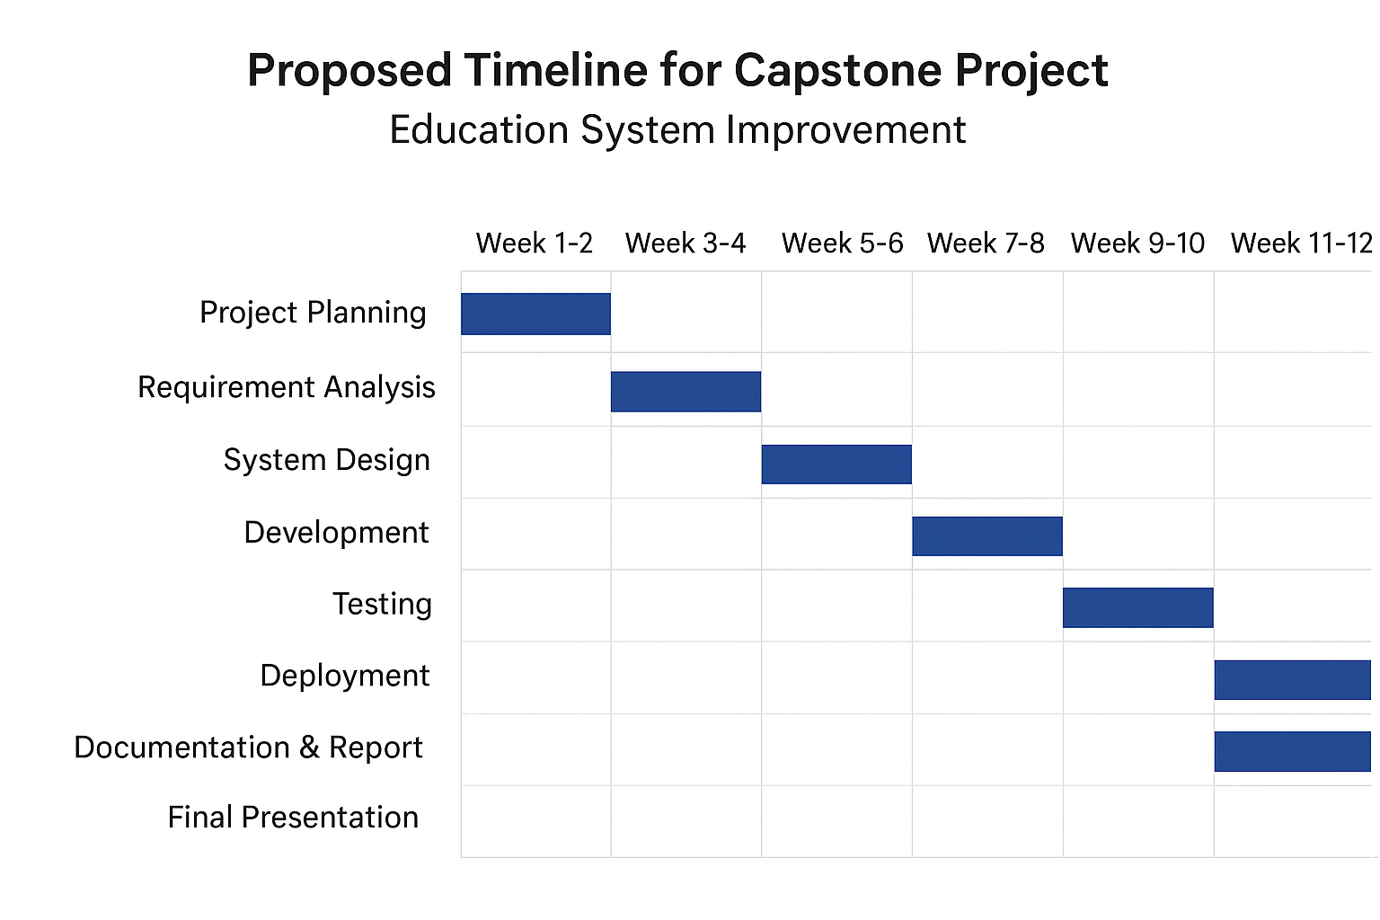
Timeline of the Project (Gantt Chart)

Slide 17
References (IEEE Paper format)
[1] Sharma and R. Singh, “Mobile learning for rural education,” IEEE Access, vol. 9, pp. 12345–12352, 2021.
[2] P. Verma, S. Gupta, and R. Mehta, “Cloud-based education systems: Opportunities and challenges,” IEEE Trans. Learning Technologies, vol. 13, no. 2, pp. 112–120, 2019.
[3] S. Pozdniakov, R. Martinez-Maldonado, S. Singh, P. Chen, D. Richardson, T. Olivier, and D. Gasevic, “Question-driven learning analytics: Designing a teacher dashboard for online breakout rooms,” in Proc. IEEE Int. Conf. Advanced Learning Technologies (ICALT), 2021, pp. 176–178.
[4] S. Lee-Cultura, K. Sharma, and M. N. Giannakos, “Multimodal Teacher Dashboards: Challenges and Opportunities of Enhancing Teacher Insights Through a Case Study,” IEEE Trans. Learning Technologies, vol. 17, no. 2, pp. 181–201, 2024.
[5] M. Ali, T. Baker, and Y. Huang, “Offline-first mobile applications: Design and implementation challenges,” IEEE Pervasive Computing, vol. 18, no. 3, pp. 14–22, 2019.
[6] A. Kebede and S. Bhattacharya, “Student Engagement Awareness Dashboard for Asynchronous E-learning Environment,” in ICT Systems and Sustainability, LNNS, vol. 321, Springer, 2022, pp. 759–771.
[7] V. A., K. Bharath, and T. N. Anitha, “A Novel Video-on-Demand System Architecture for E-Learning in Rural Regions of India,” in Proc. Int. Conf. Computational Intelligence and Applications (ICCIA), 2012, pp. 1–5.
[8] UNESCO, Education for All Global Monitoring Report, Paris, France: UNESCO, 2020.
[9] World Bank, “Digital Inclusion in Education,” Washington, DC, 2021.
[10] J. Brown, A. Smith, and L. White, “Bridging the digital divide: ICT adoption in underserved communities,” IEEE Internet Computing, vol. 24, no. 5, pp. 44–50, 2020.

Slide 18


